Slide 1
Internet of Things (Finance)
iQ4 Virtual Vault
Notes:
Banks from all over the world are trying to use IoT capabilities in their industry to get more customers involved. Starting from mobile banking apps that today are used by the majority of all world banks, since apps help monitor preferences of customers, to the range of sensors that make it possible for financial institutions to gather information from their branches and sensors in wearables that can track how customers use banking products. The Internet of Things and financial services create a beneficial combination. IoT helps prevention of fraud in FinTech applications using Artificial Intelligence. IoT and AI can become the symbiosis can enhance and improve the process of fighting the cybercrime.

Slide 2
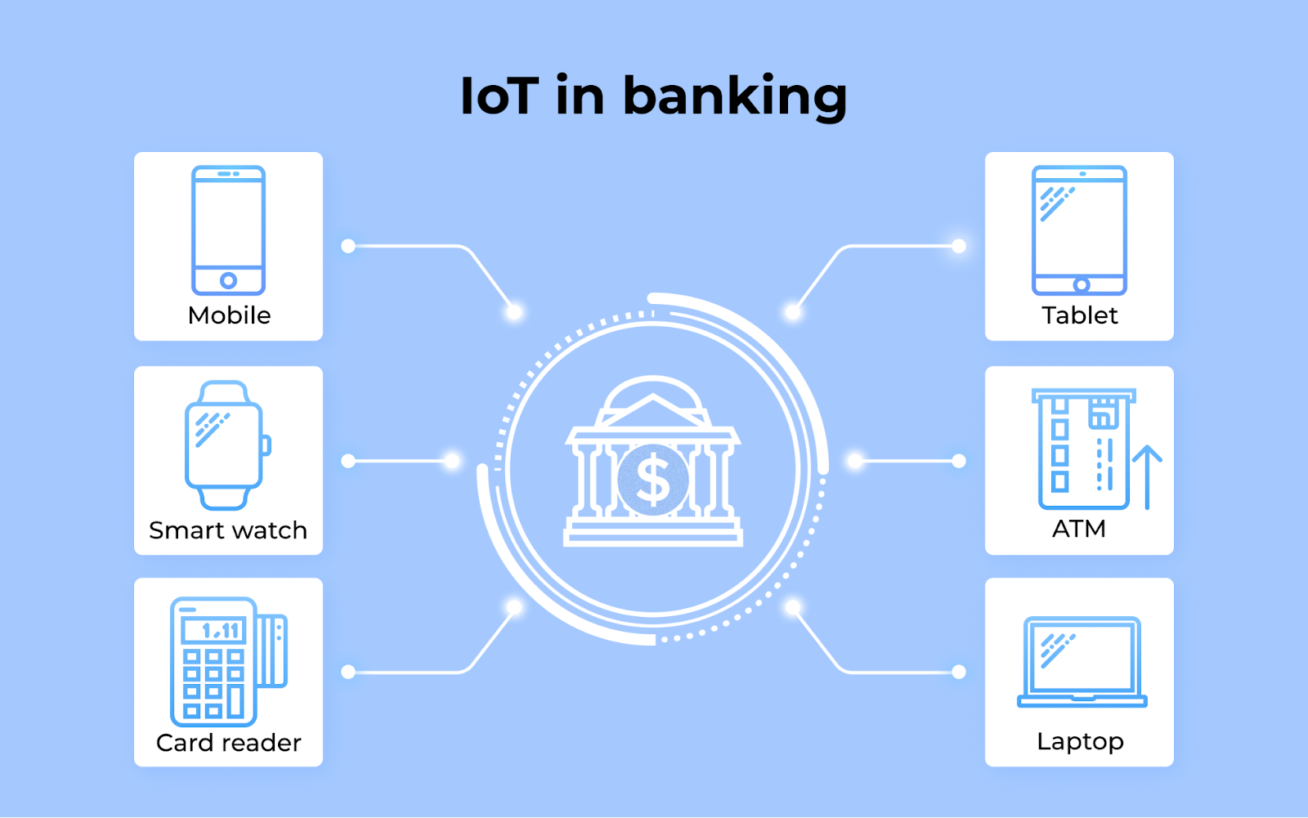
Overview of types IoT used in Finance
Chatbot
Wearable Devices
Card Readers
Mobile
Tablets
Laptop
ATM
Notes:
IoT technology has its second side that will show some pitfalls IoT brings to humanity. Especially if it concerns finances where accuracy and security are highly important. All benefits shown above will bring some problems related to confidentiality and security of customers' personal data. The financial field that uses IoT connections should make sure the safety of personal data to their customers. Since IoT is the whole network of devices and various software, the risk of hacking is increasing exponentially. And in case of financial industry, the privacy and security are the most important issues to be taken into account when thinking about protection. When the financial and personal information is being transmitted through the IoT network, all this data can be breached and hacked. So the privacy and security concern means a lot and rapt attention should be paid to it.

Slide 3
Potential Impact
Privacy & security
No common standards
Risk of Hacking
Tracking real-time state
Notes:
When financial and personal information is being transmitted through the IoT network, the data can be breached and
hacked.
Different devices require different maintenance approach. There are no common standards for maintaining IoT.
The matter is that all hardware used in IoT can be manufactured by different suppliers and they cannot have one common maintenance standard. And even if all hardware manufacturers in the world will agree to use one specific standard, technical issues will still remain. Only if there will be one monopolistic manufacturer of all equipment, but it is unreal since it will damage economic situation in the whole world. So, the lack of common standards can be the reason for failures in the functionality of IoT devices.

Slide 4
How vulnerable Financial IoT is to attack
Ripe Targets for Cybercriminals
57% of IoT devices are vulnerable to medium- or high-severity attacks according to the 2019 Gartner Report.
98% of all devices are unencrypted, exposing confidential data.
Notes:
Finance Industry is growing exponentially and is expanding its network of devices with IP phones, printers, intercom systems, and security cameras. More than 30% of all network-connected endpoints are IoT devices and a 2019 Gartner report found the adoption of enterprise IoT grew 21.5% from 2018 to 2019, totaling an estimated 4.8 billion devices. Overall, they found that “the general security posture of IoT devices is declining, leaving organizations vulnerable to new IoT-targeted malware as well as older attack techniques that IT teams have long forgotten.” Researchers also discovered “a shift away from attackers’ primary motivation of running botnets to conduct DDoS attacks via IoT devices to malware spreading across the network via worm-like features, enabling attackers to run malicious code to conduct a large variety of new attacks.” Password-related attacks were also found to be prevalent on IoT devices because of weak manufacturer-set passwords and poor password security practices. Due to the overall lack of security measures in place, the report estimates 57% of IoT devices are vulnerable to medium- or high-severity attacks. Researchers also discovered 98% of all devices are unencrypted, exposing personal and confidential data on the network.

Slide 5
Steps to reduce risks
Standardization
Consider Zero Trust
Discover IoT devices on the network
Patch printers and other easily patchable devices
Segment IoT devices across VLANs
Enable active monitoring
Think holistically — orchestrate the entire IoT lifecycle
Expand security to all IoT devices through product integration
Notes:
The 2020 Unit 42 IoT Threat Report advises the Chief Security Officers to take the following steps.
Standardization is the process of creating a more uniform, consistent IT environment by limiting the number of systems, devices, applications, services and configurations

